Slide 1
LAPORAN UJIAN PRESTASI Sistem HESK
Pusingan 1
16 Mac 2023

Slide 2
KANDUNGAN
Objektif
Skop Ujian
Persediaan dan Pelaksanaan Ujian
Kriteria Penilaian
Keputusan Ujian
Rumusan dan Syor

Slide 3
OBJEKTIF
Menguji prestasi infrastruktur dan keupayaan Sistem HESK beroperasi dengan sejumlah bebanan/ pengguna secara serentak dalam tempoh masa tindakbalas yang ditetapkan.

Slide 4
SKOP UJIAN
Bil. | Skop | Nilai
1. | Bilangan Pengguna Serentak | 500 pengguna
2. | Purata Masa Tindakbalas | <= 5 saat
3. | Transaksi Bisnes Cipta Aduan Papar laporan | 1 transaksi bisnes
4. | Ujian Beban | 1,000 pengguna

Slide 5
PERSEDIAAN DAN PELAKSANAAN UJIAN
1. Infrastruktur dan Server Sistem Aplikasi
1 NLB Server
4 CPU, 4 GB RAM
2 Application Server
4 CPU, 32 GB RAM
1 Database Server
4 CPU, 8 GB RAM

Slide 6
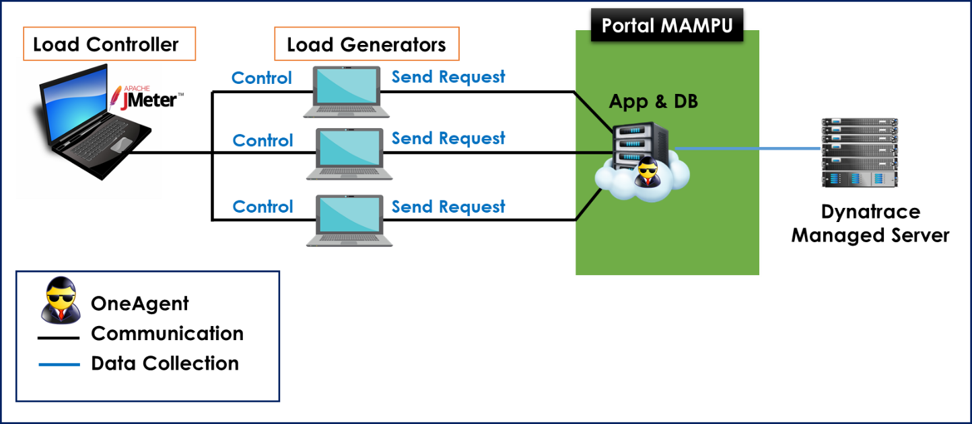
PERSEDIAAN DAN PELAKSANAAN UJIAN
2. Infrastruktur dan Server Pengujian
Sistem ePharmacist
Perfmon

Slide 7
3. Skrip Pengujian
PERSEDIAAN DAN PELAKSANAAN UJIAN
Skrip telah dibangunkan pada 14 - 16 Mac 2023
2 Transaksi Bisnes
Cipta Aduan
Papar Laporan

Slide 8
4. Data Pengujian
PERSEDIAAN DAN PELAKSANAAN UJIAN
1,000 data pengguna
10 data administrator

Slide 9
5. Pelaksanaan Ujian Beban
PERSEDIAAN DAN PELAKSANAAN UJIAN
Bil. | Transaksi Bisnes | Wajaran (%) | Peringkat 1 | Peringkat 2 | Peringkat 3 | Pengujian Tekanan
1. | Laman Utama, Login, Create Ticket, Maklumat Aduan, Submit, Home, Logout | 90 | 90 | 500 | 1,000 | 2,000
2. | Laman Utama, Login, Papar Laporan, Logout | 10 | 10 | 500 | 1,000 | 2,000
 | JUMLAH | 100 | 100 | 300 | 500 | 1,000

Slide 10
KRITERIA PENILAIAN
Bil. | Kriteria | Nilai
1. | Application Performance Index (APDEX) | > 0.85
2. | Purata Masa Tindakbalas | <= 5 saat
3. | Peratus Ralat (Error and Exception) | < 2%
4. | Kapasiti Penggunaan Server (CPU dan RAM) | < 80%

Slide 11
Application Performance Index (APDEX)
Apdex (Application Performance Index) is an open standard developed by an alliance of companies that defines a standardized method to report, benchmark, and track application performance.
Apdex is a numerical measure of user satisfaction with the performance of enterprise applications. It converts many measurements into one number on a uniform scale of 0-to-1 (0 = no users satisfied, 1 = all users satisfied)
The index is based on three zones of application responsiveness:
Satisfied: The user is fully productive. This represents the time value (T seconds) below which users are not impeded by application response time.
Tolerating: The user notices performance lagging within responses greater than T, but continues the process.
Frustrated: Performance with a response time greater than F seconds is unacceptable, and users may abandon the process.

Slide 12
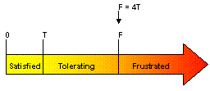
Application Performance Index (APDEX)
The Apdex formula is the number of satisfied samples plus half of the tolerating samples plus none of the frustrated samples, divided by all the samples:
For example, if there are 100 samples with a target time of 3 seconds, where 60 are below 3 seconds, 30 are between 3 and 12 seconds, and the remaining 10 are above 12 seconds, the Apdex is:

Slide 13
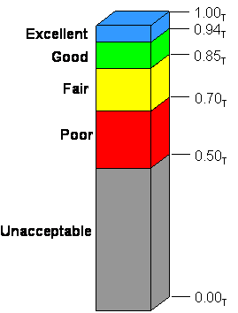
Application Performance Index (APDEX)
What is good APDEX value?
Apdex values fall between 0 and 1 where, 0 means that no users are satisfied and 1 indicates that all user samples were in the satisfied zone. Clearly, a higher number is better.
References: http://www.apdex.org/

Slide 14
KEPUTUSAN UJIAN Pusingan 1 16 Mac 2023

Slide 15
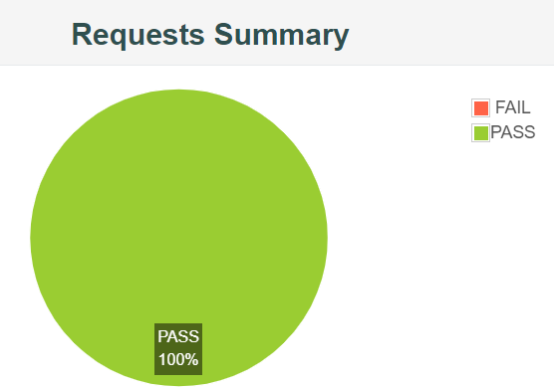
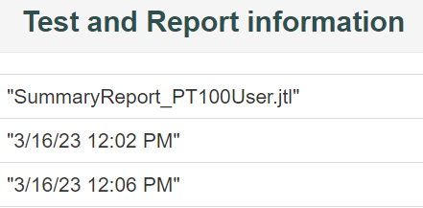
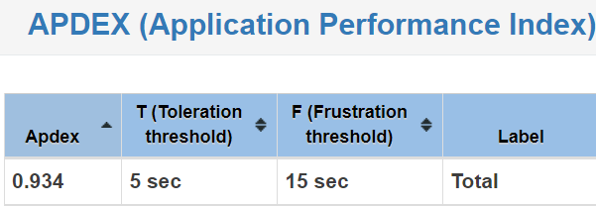
Ujian Beban 100 pengguna serentak
APDEX : 0.934

Slide 16
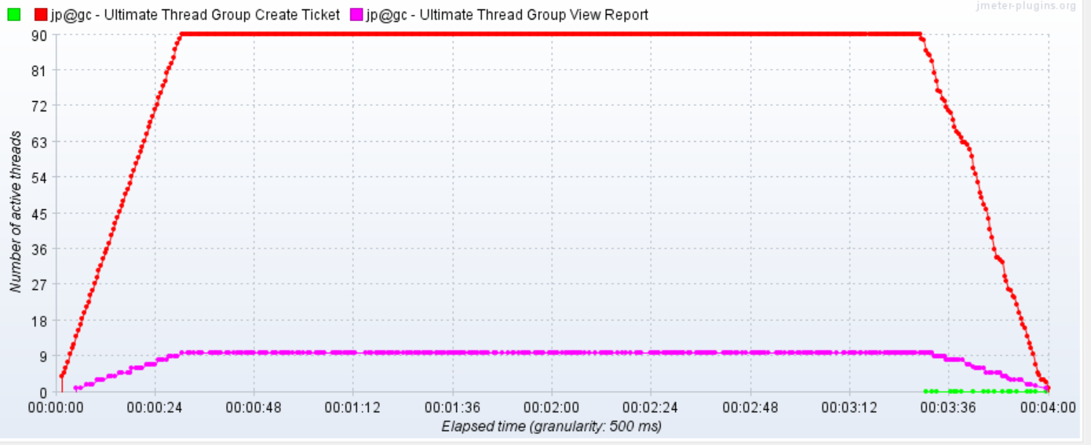
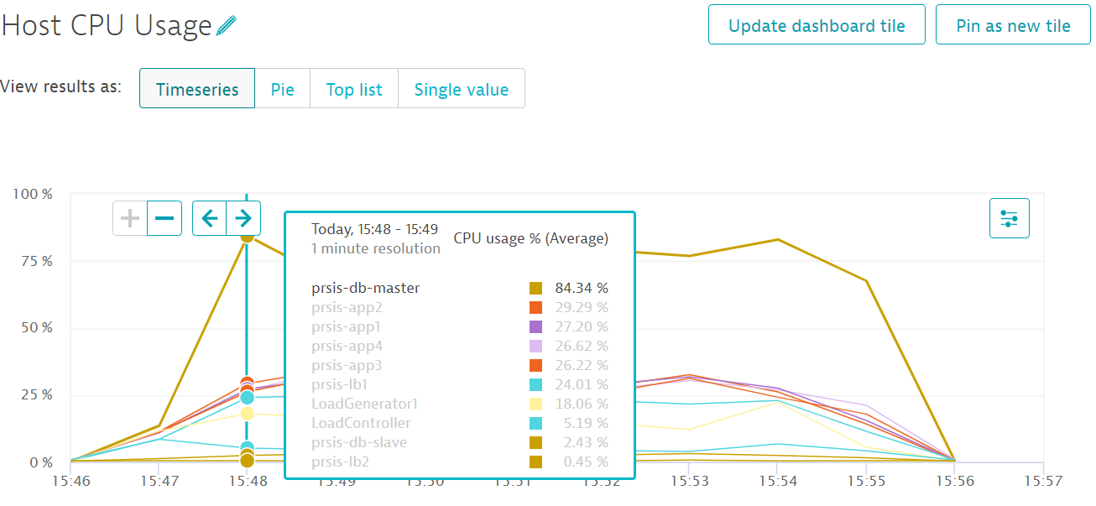
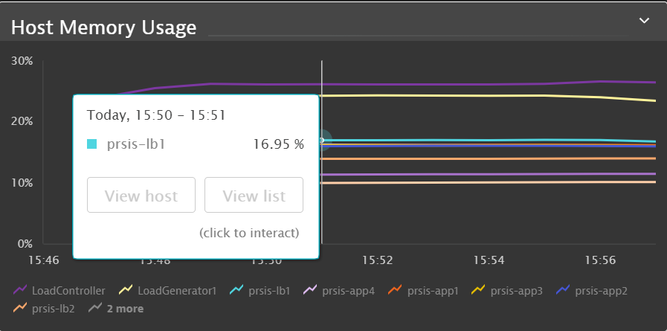
Ujian Beban (1) 100 pengguna
Kriteria Penilaian | Pusingan 1
APDEX | 0.934
Purata Masa Tindakbalas | 1.9 saat
Ralat | 0.0 %
Kapasiti Penggunaan Server
1) CPU | 84.34 %
2) RAM | 16.95 %
KEPUTUSAN | LULUS

Slide 17
Ujian Beban 300 pengguna serentak
APDEX : 0.934

Slide 18
Ujian Beban (1) 300 pengguna
Kriteria Penilaian | Pusingan 1
APDEX | 0.934
Purata Masa Tindakbalas | 1.9 saat
Ralat | 0.0 %
Kapasiti Penggunaan Server
1) CPU | 84.34 %
2) RAM | 16.95 %
KEPUTUSAN | LULUS

Slide 19
RUMUSAN DAN SYOR

Slide 20
RUMUSAN
Ujian Beban bagi 100 pengguna serentak adalah LULUS
Ujian Beban bagi 300 pengguna serentak adalah GAGAL
Kapasiti penggunaan server (database server) adalah 95.34% > 80%
Ralat adalah 24.39% > 2%
APDEX adalah 0.599 < 0.85%

Slide 21
SYOR
Application Server (CPU) perlu dipertingkatkan bagi menampung bebanan sehingga 1,000 pengguna serentak
Cadangan dipertingkatkan dari 4CPU kepada 8 CPU

Slide 22
Terima Kasih
Pasukan MyTCoE, MAMPU
03-8000 8000
mytcoe@mampu.gov.my
https://sqa.mampu.gov.my

